Slide 1

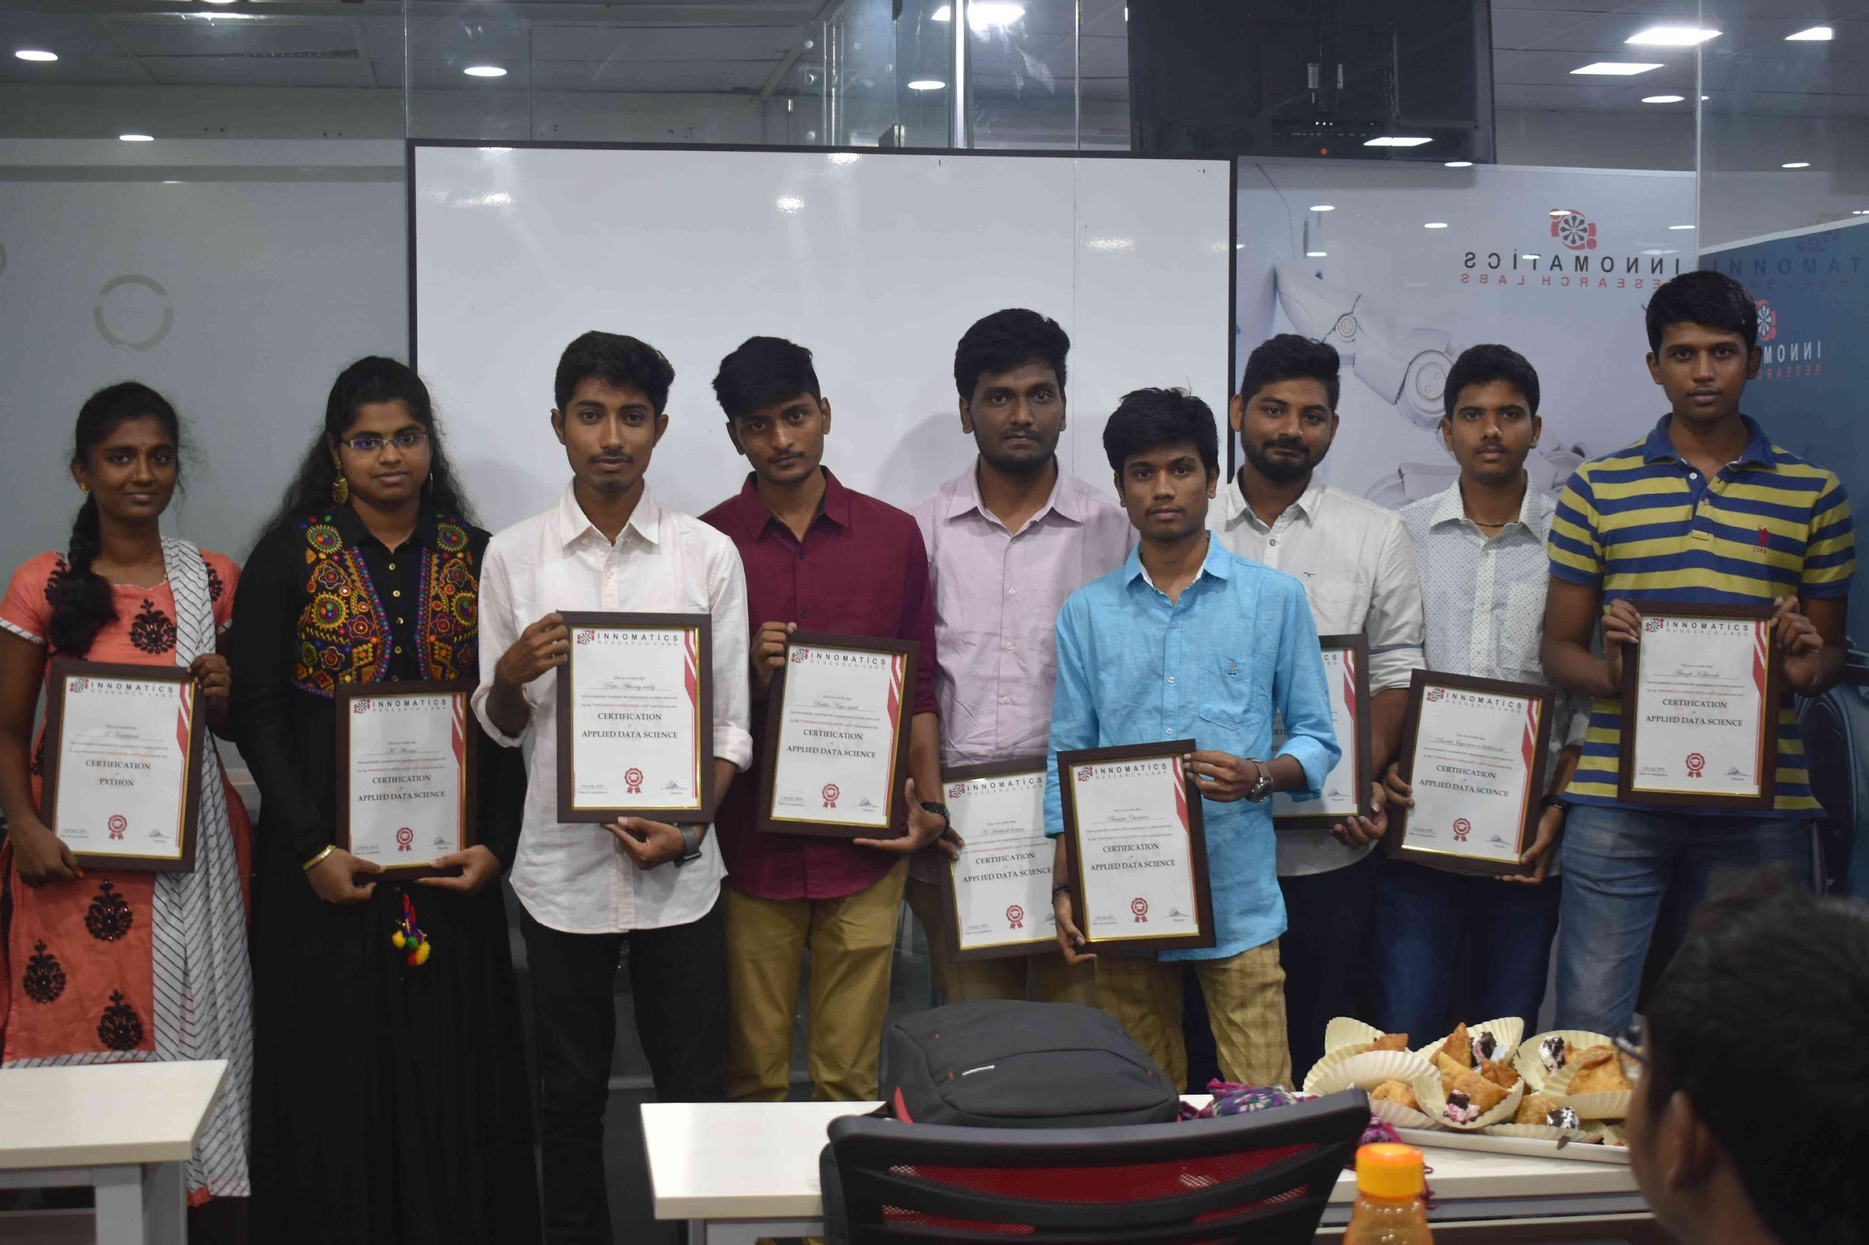
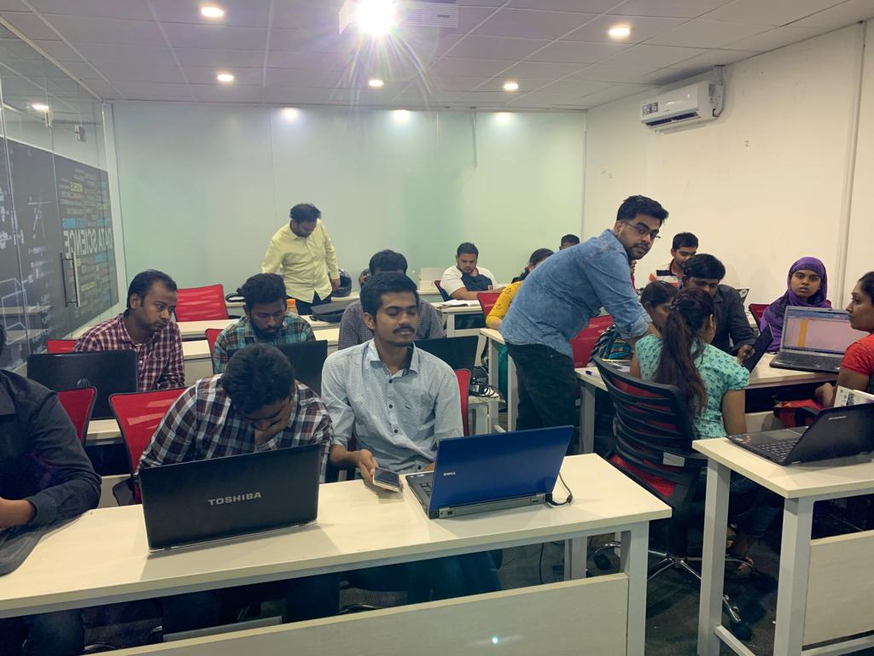


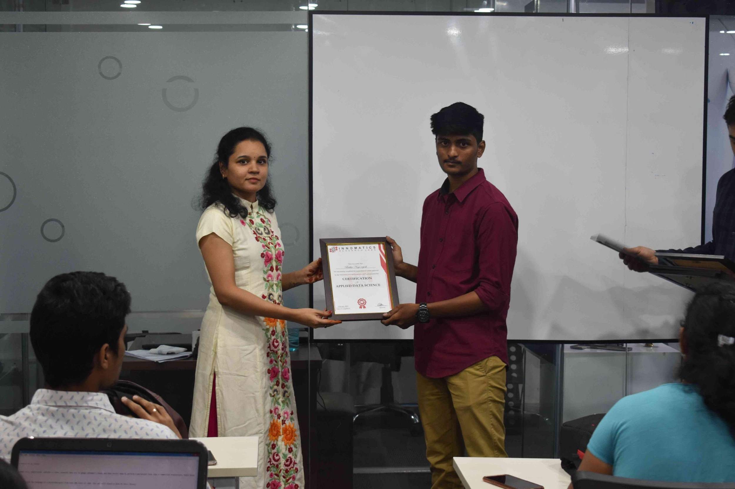
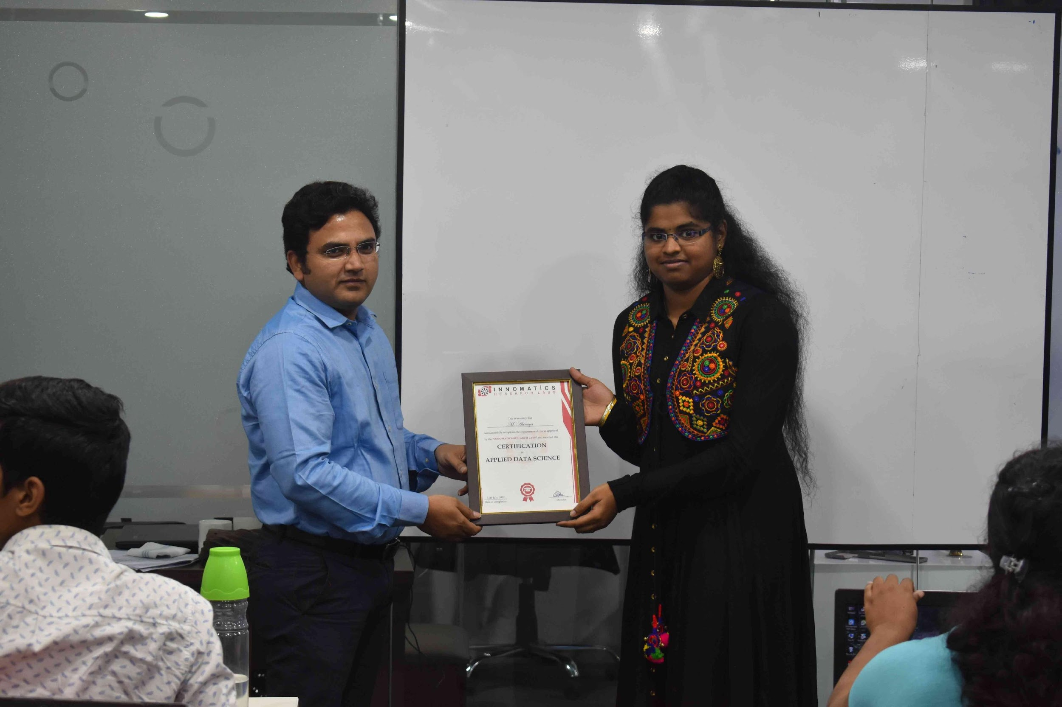

Slide 2
ABOUT ME
HAREG BUNKER
Educational Background
Bachelor in Engineering (Mechanical Engineering)
Work Experience
Worked 1 year in automobile industry
NSSl Neco Group (FVD) Nagpur
Gestamp Automotive India Pune

Slide 3
EDA ON AMCAT EXAM DATASET

Slide 4
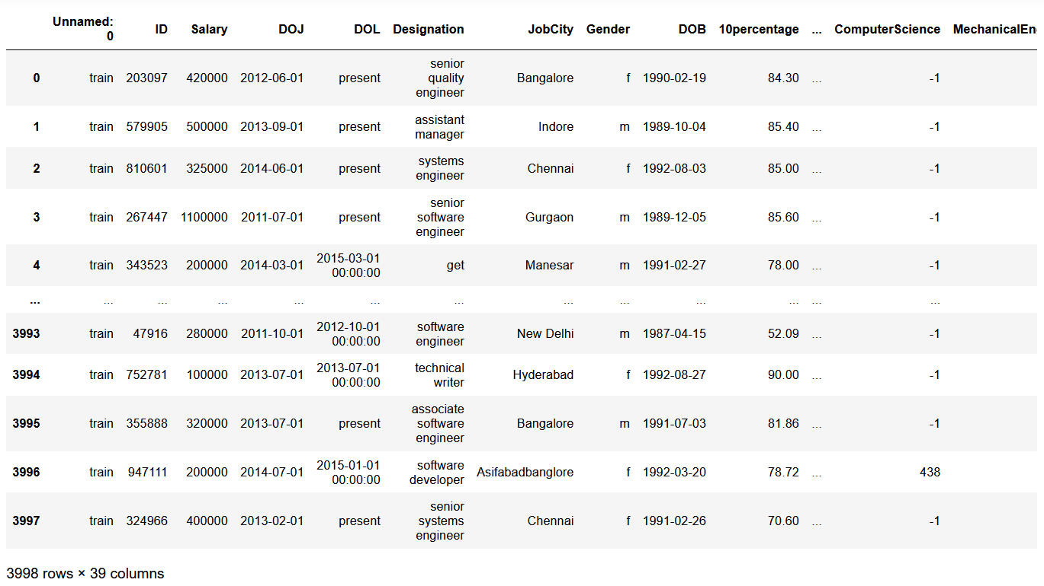
RAW DATA SET

Slide 5
DATA MANIPULATION
Specialization column has different names for same department
Designation column has different names for same position
Job City column has spelling mistakes

Slide 6
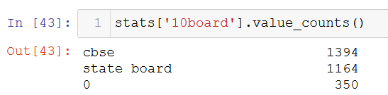
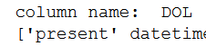
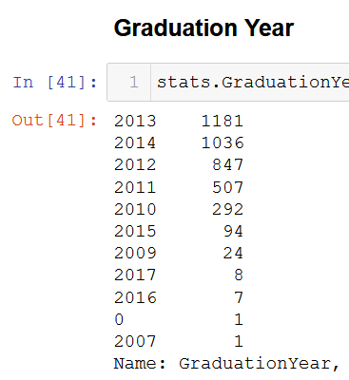
DATA CLEANING
Dropped unwanted columns:
Unnamed:”0",'CollegeCityID','ElectricalEngg',"CollegeID","Domain”, ”ID”
10board and 12board column has 0 in it
DOL column is in object since it has present written in it
Graduation Year column 0 has in it

Slide 7
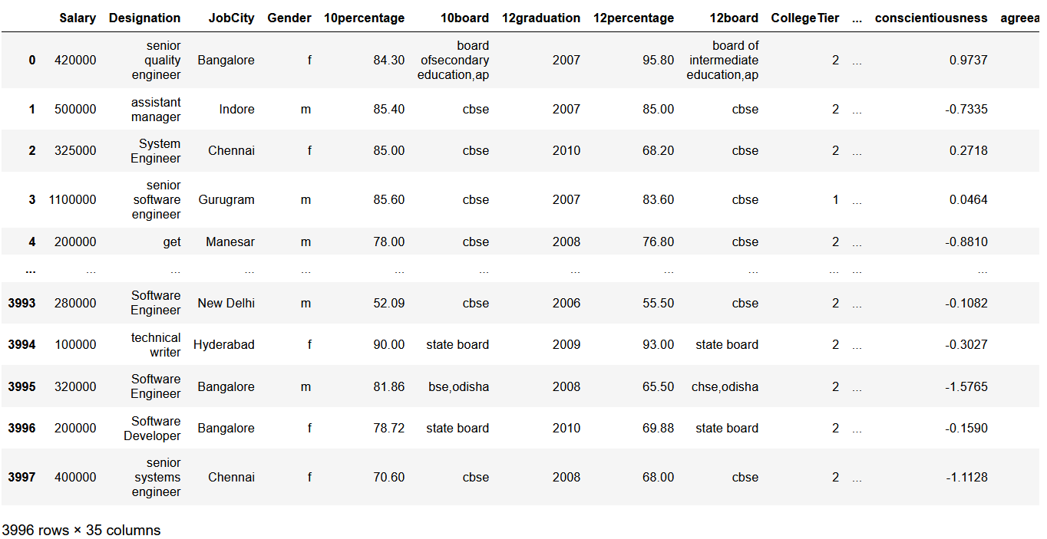
CLEANED DATAFRAME

Slide 8
UNIVARIANTE ANALYSIS

Slide 9
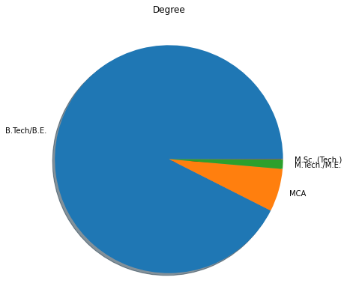
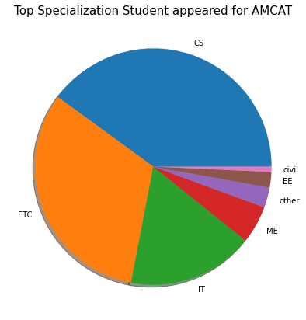
B.Tech/B.E are more
CS, ETC and IT Branch student are giving more this exam

Slide 10
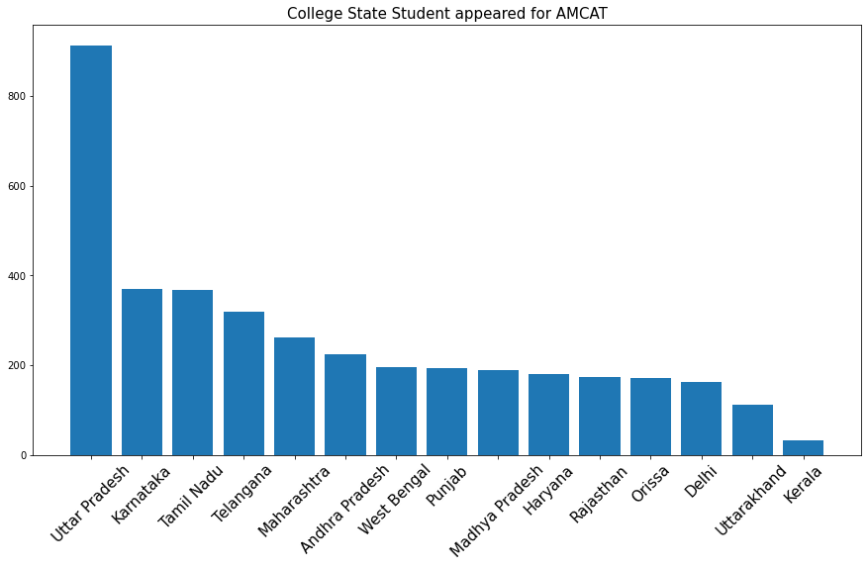
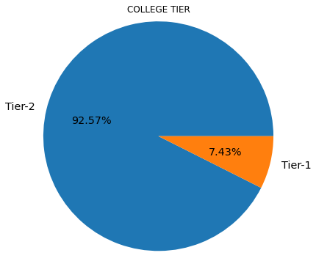
UP, Karnataka, Tamil Naidu, Telangana and Maharashtra student are giving more AMCAT exam
Tier-2 cities student are giving more AMCAT exam

Slide 11
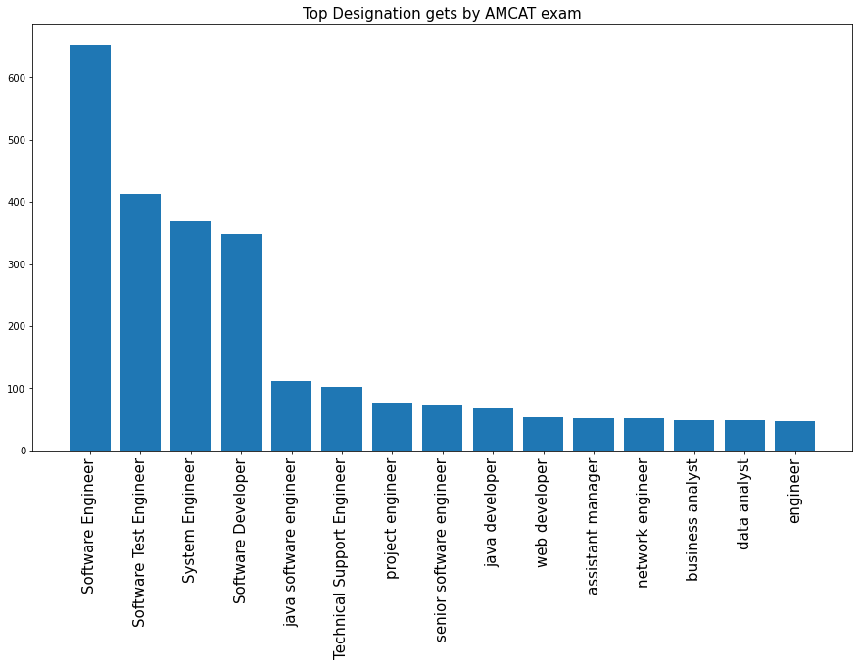
Job roles getting more by AMCAT exam are :
Software engineer
Software test engineer
System engineer
Software developer

Slide 12
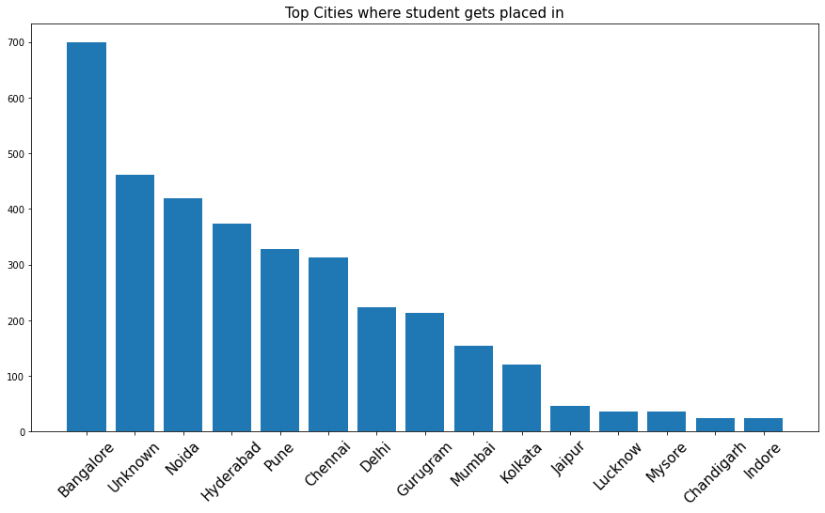
Bangalore , Noida, Hyderabad, Pune have more no. of jobs available

Slide 13
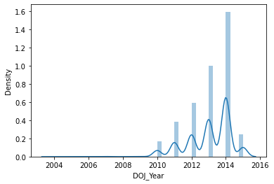
Joining increases as the year increases
2014 has highest joining

Slide 14
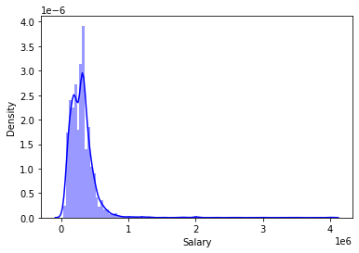
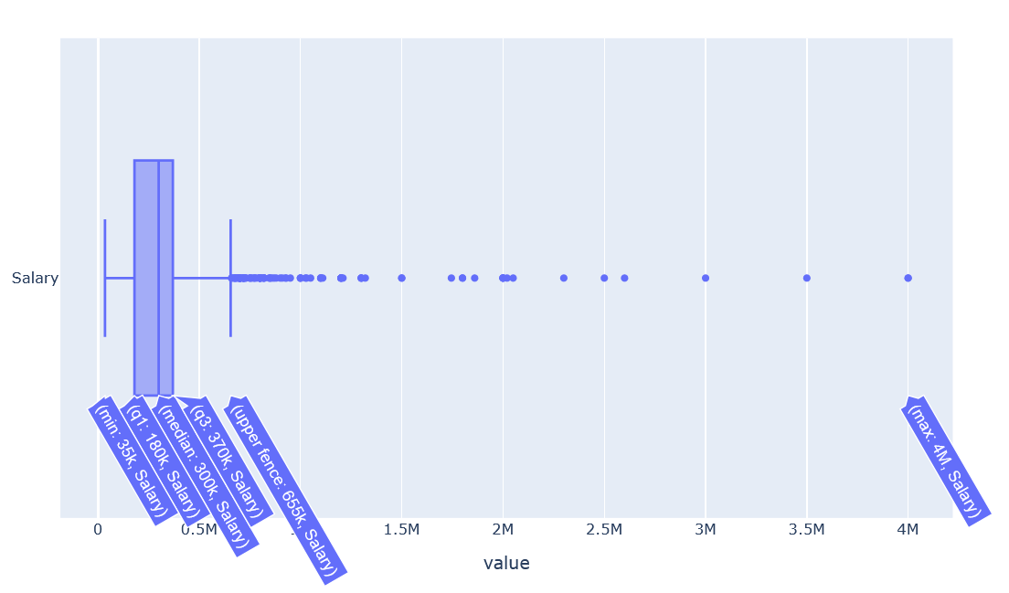
Distribution is right skewed means most of the people has less salary.
Right whisker is 6.5 lac more than that are outliers
Salary are between 35k to 40lac CTC
IQR means 50% of data between 2lac to 3.7 lac

Slide 15
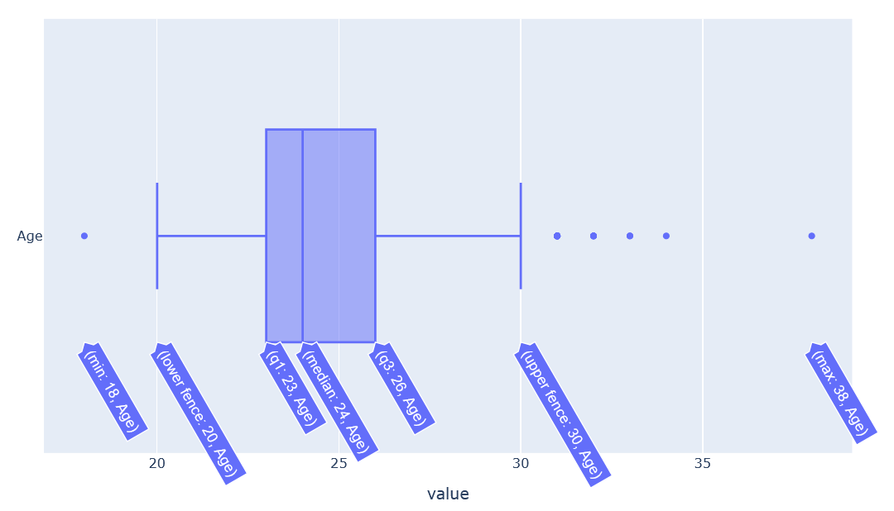
Age between 20 to 30 student are giving more AMCAT exams

Slide 16
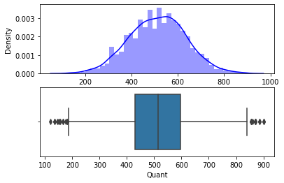
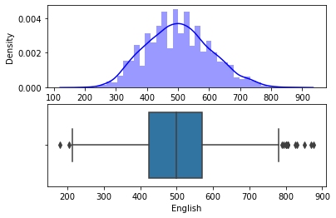
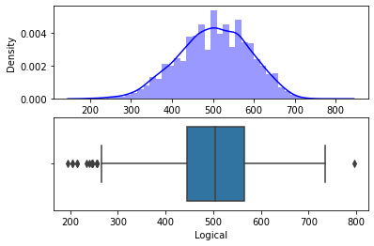
The most of the quant range is between 430 to 595.
The least value is 120.
The highest value is 900
The most of the english marks range is between 425 to 570.
The least value is 180.
The highest value is 875.
The most of the logical marks range is between 445 to 565.
The least value is 195.
The highest value is 795

Slide 17
BIVARIANTE ANALYSIS

Slide 18
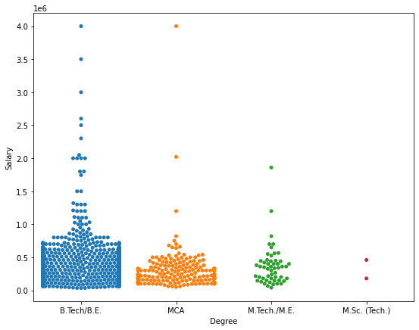
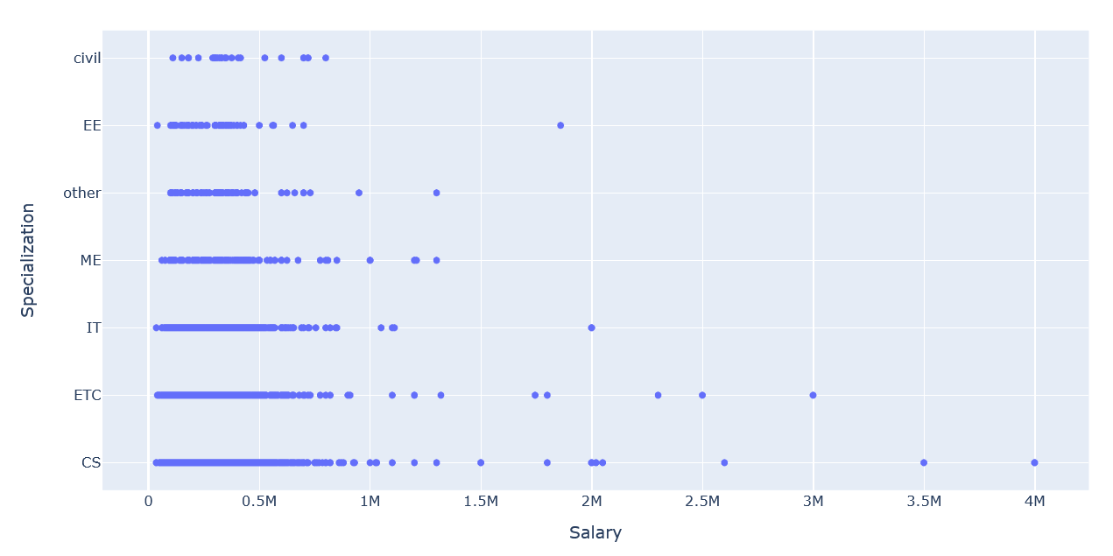
Analysis of Salary with various Variables
B.Tech/BE and MCA has highest salary
But Btech/BE gives wide range salary
CS,IT and ETC branch candidate highest salary

Slide 19
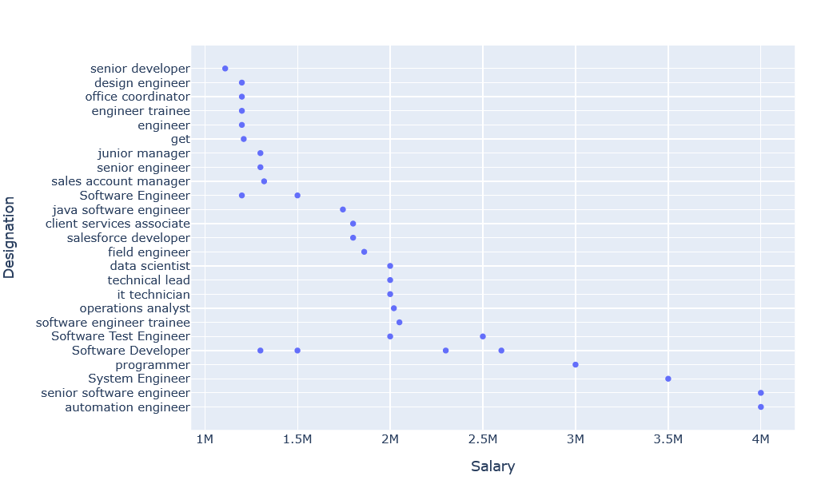
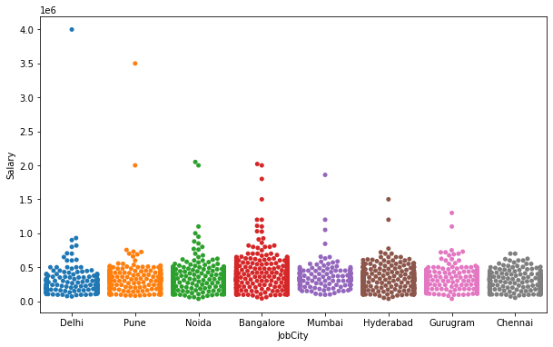
Roles that has the highest salary are:
Automation Engineer
Senior Software Engineer
System Engineer
Delhi and Pune has the highest salary
Noida, Bangalore and Hyderabad give wide range of salaries

Slide 20
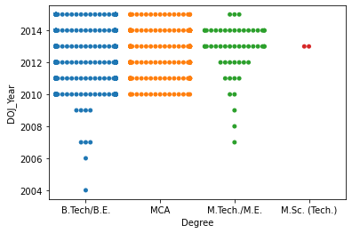
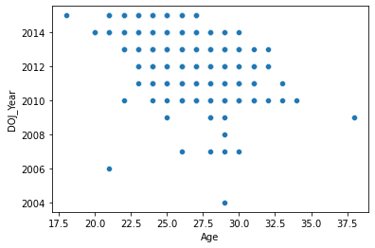
Analysis of Joining Year with various Variables
B.Tech/B.E and MCA gives highest joining in between 2010 to 2014
Age between 23 to 30 has highest joining in 2010 to 2014

Slide 21
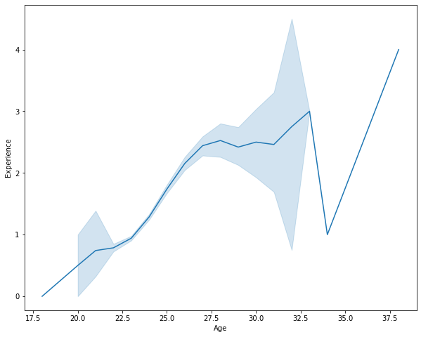
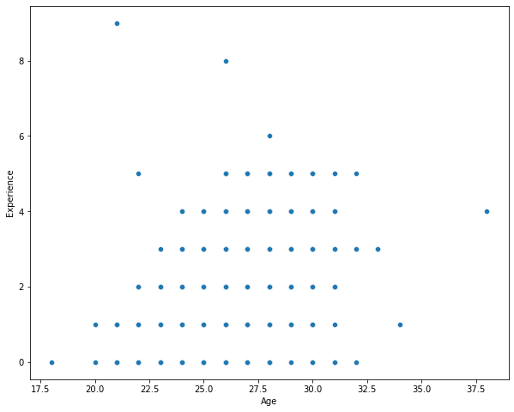
Analysis of Age with Experience
As the age increases the experience also increases
Age between 26 to 31 candidate gets wide range experience after AMCAT exam

Slide 22
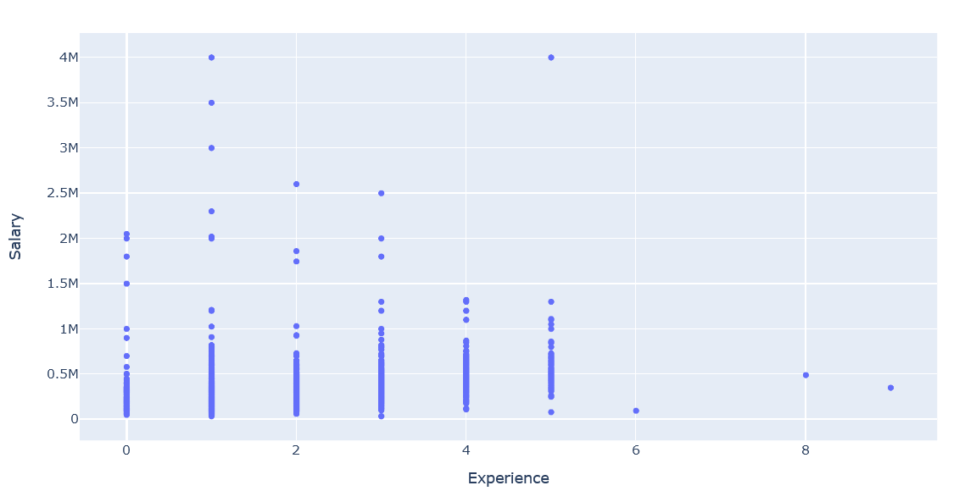
Analysis of Experience with Salary
After giving AMCAT Exam
candidate getting salaries upto 15 to 40 lacs packages for 0 to 3 year exp.
0 to 5 year experience getting wide range of salaries
Fresher also getting packages upto 20 lacs

Slide 23
MULTI-VARIANTE ANALYSIS

Slide 24
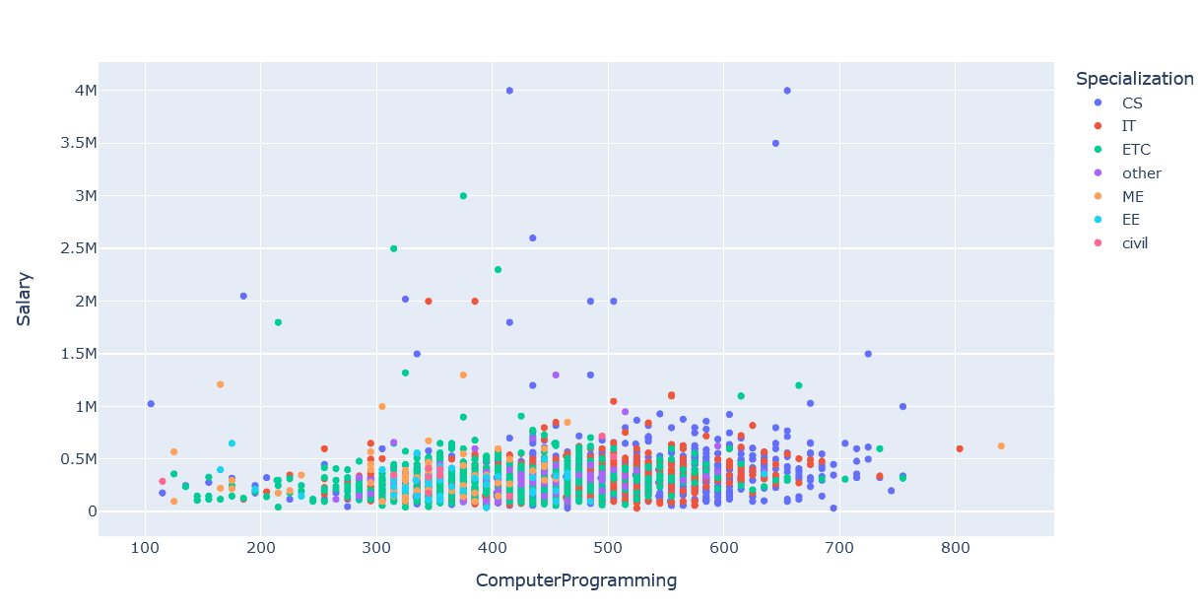
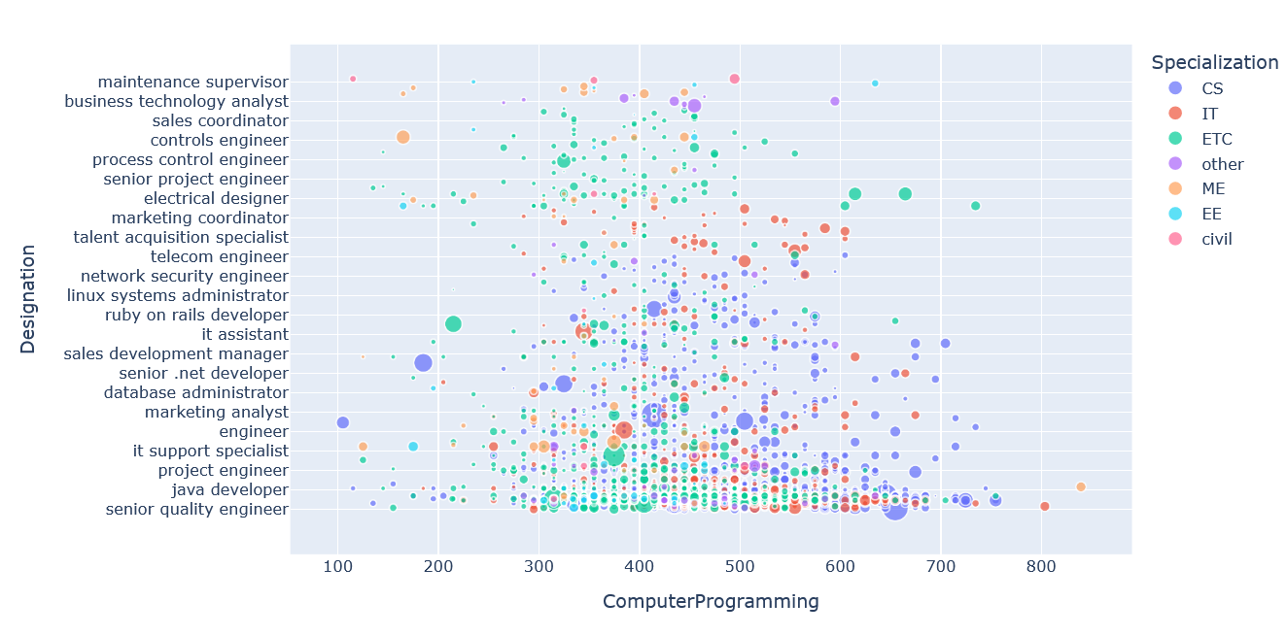
Salary Range between 35k to 40 Lakhs
Score between 190 to 650 high salary range

Slide 25
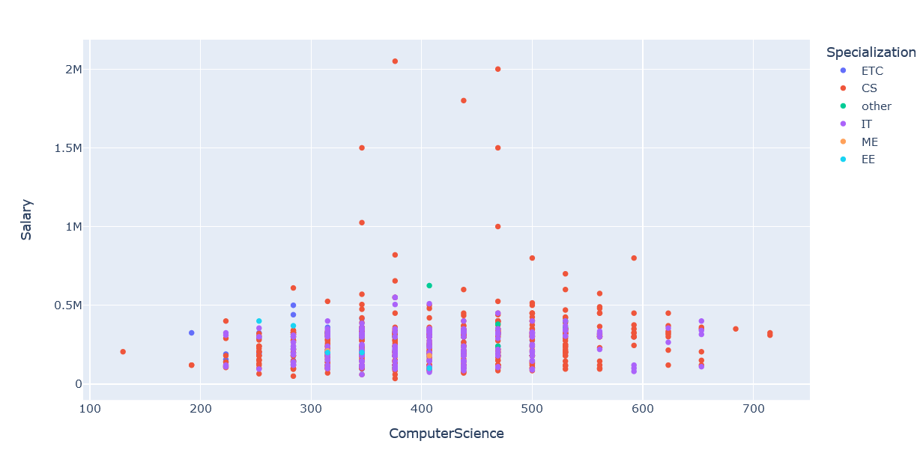
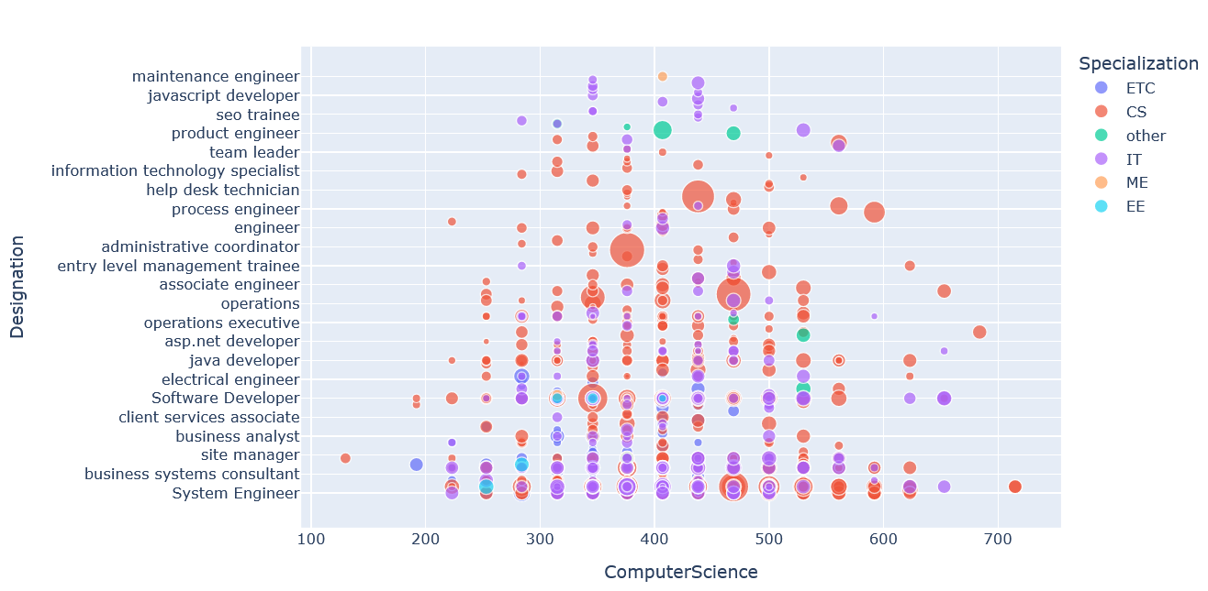
Salary Range between 35 k to 21 lakhs
Score between 275 to 500 high salary range

Slide 26
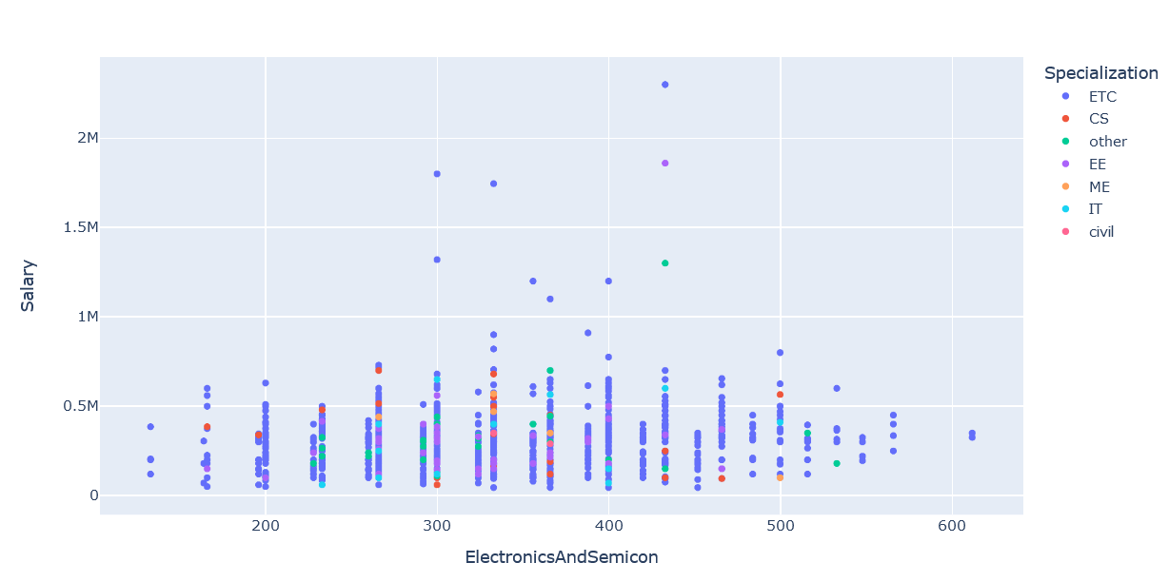
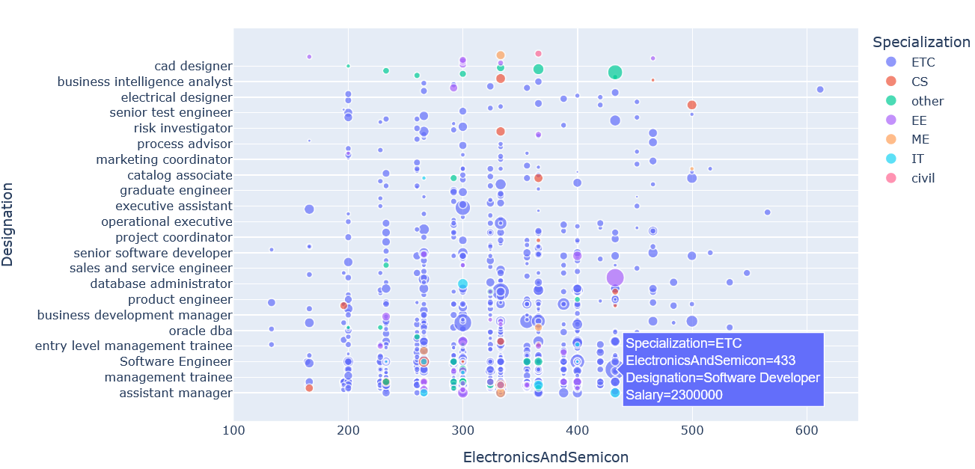
Salary Range between 35k to 23 Lakhs
Score between 275 to 450 high salary range

Slide 27
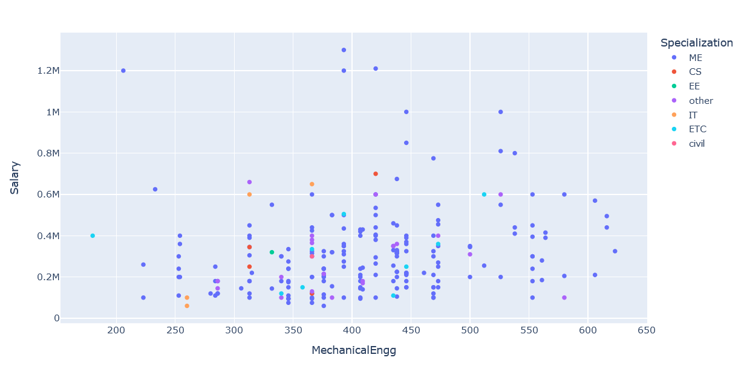
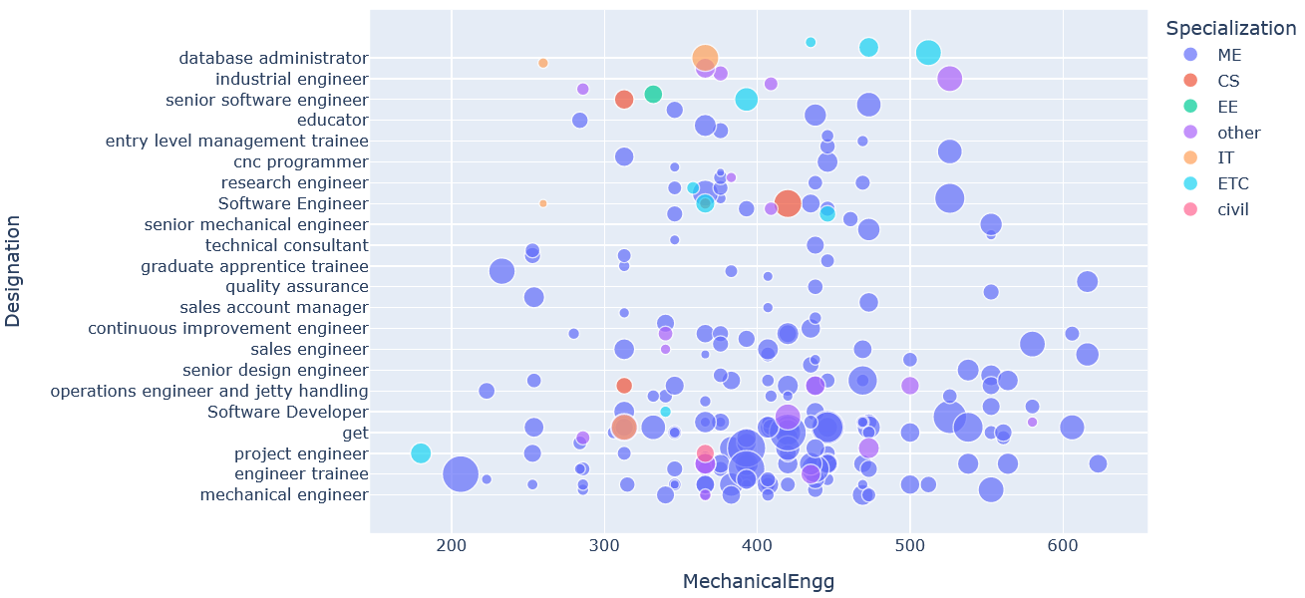
Salary Range between 1 lakhs to 13 Lakhs
Score between 275 to 500 high salary range

Slide 28
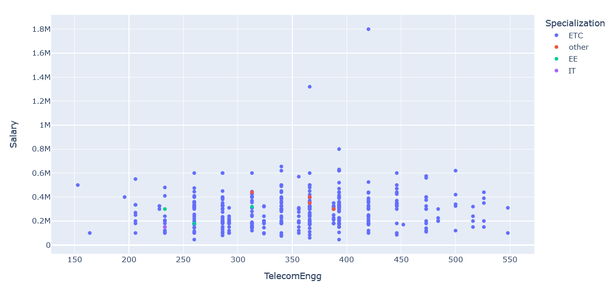
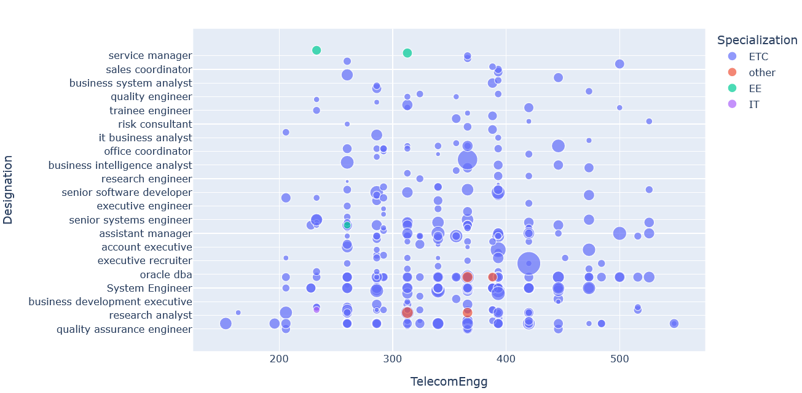
Salary Range between 1 lakhs to 18 Lakhs
Score between 275 to 450 high salary range

Slide 29
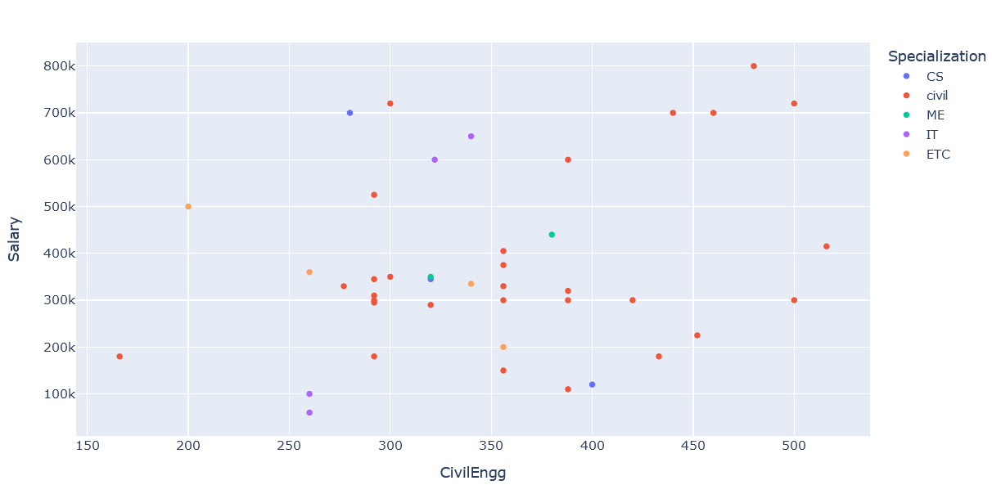
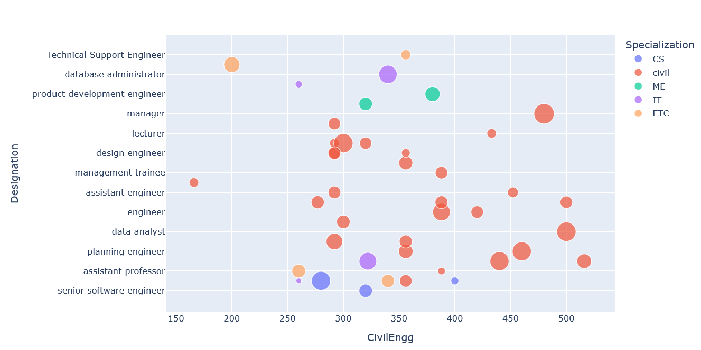
Salary Range between 1 lakhs to 8 Lakhs
Score between 275 to 500 high salary range

Slide 30
CONCLUSION
BTech /B.E and MCA has highest salary and highest joining in between 2010 to 2014
CS,IT and ETC branch candidate highest salary
Software engineer, Software test engineer, System engineer and Software developer roles has the highest salary
Delhi and Pune has the highest salary. But Bangalore , Noida, Hyderabad, Pune have more no. of jobs available and give wide range of salaries
2014 has highest joining
AMCAT exam with low and intermediate score also getting high salary packages

Slide 31

THANK
YOU

